Slide 1






FIFA CLUB Web API
Jacob T. Linao Cohort 23052022

Slide 2




AGENDA
Introduction
Features
Summary

Slide 3



INTRODUCTION
With the FIFA Club API, you can view, build, and play your
ultimate FIFA Team.
With over 30 teams and hundreds of players, the possibilities are endless!
Built with Microsoft Visual Studios and Microsoft SQL Server, the best decent FIFA experience is just a click away!

Slide 4

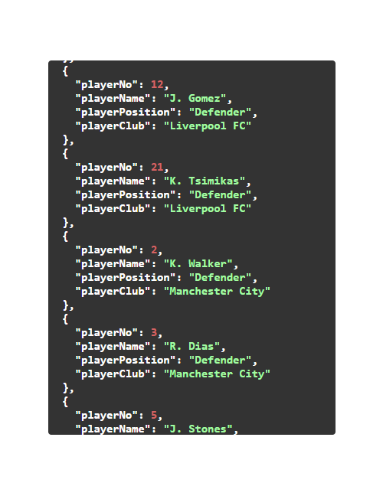
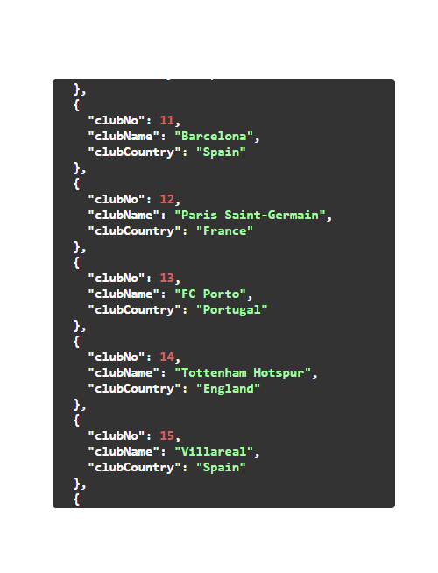
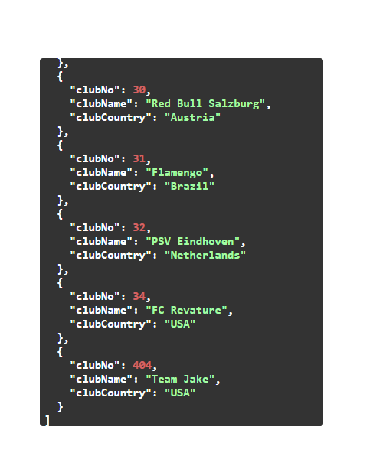
FEATURES
BROWSE PLAYERS
BROWSE
TEAMS
A work of art…always in progress
ADD YOUR OWN TEAMS!
($1.99)

Slide 5

SUMMARY
FiFa Club is continuously a work in progress. As more technologies are made readily available, more features are sure to be added! FiFa Club is not only a project, a work of art that handles like a tool to bring FiFa entertainment one button click away!

Slide 6
THANK YOU
Jacob T. Linao
jacob638@revature.net
github.com/jacobtlin/My-Repository.git

